Slide 1
July 1, 2026
Hari Naicker
Biweekly Meeting
System Setup Recap

Slide 2
Overview
Improved NCFL in preparation for Python integration with additional control settings, higher fidelity components(HX and heaters), and easier to update dimensions.
Met with Jack and Linyu individually.
Began writing Python script to execute Dymola simulations without modifying parameters in Dymola itself.
Installed DeepLynx and began exploring different features in preparation for NCFL implementation.

Slide 3
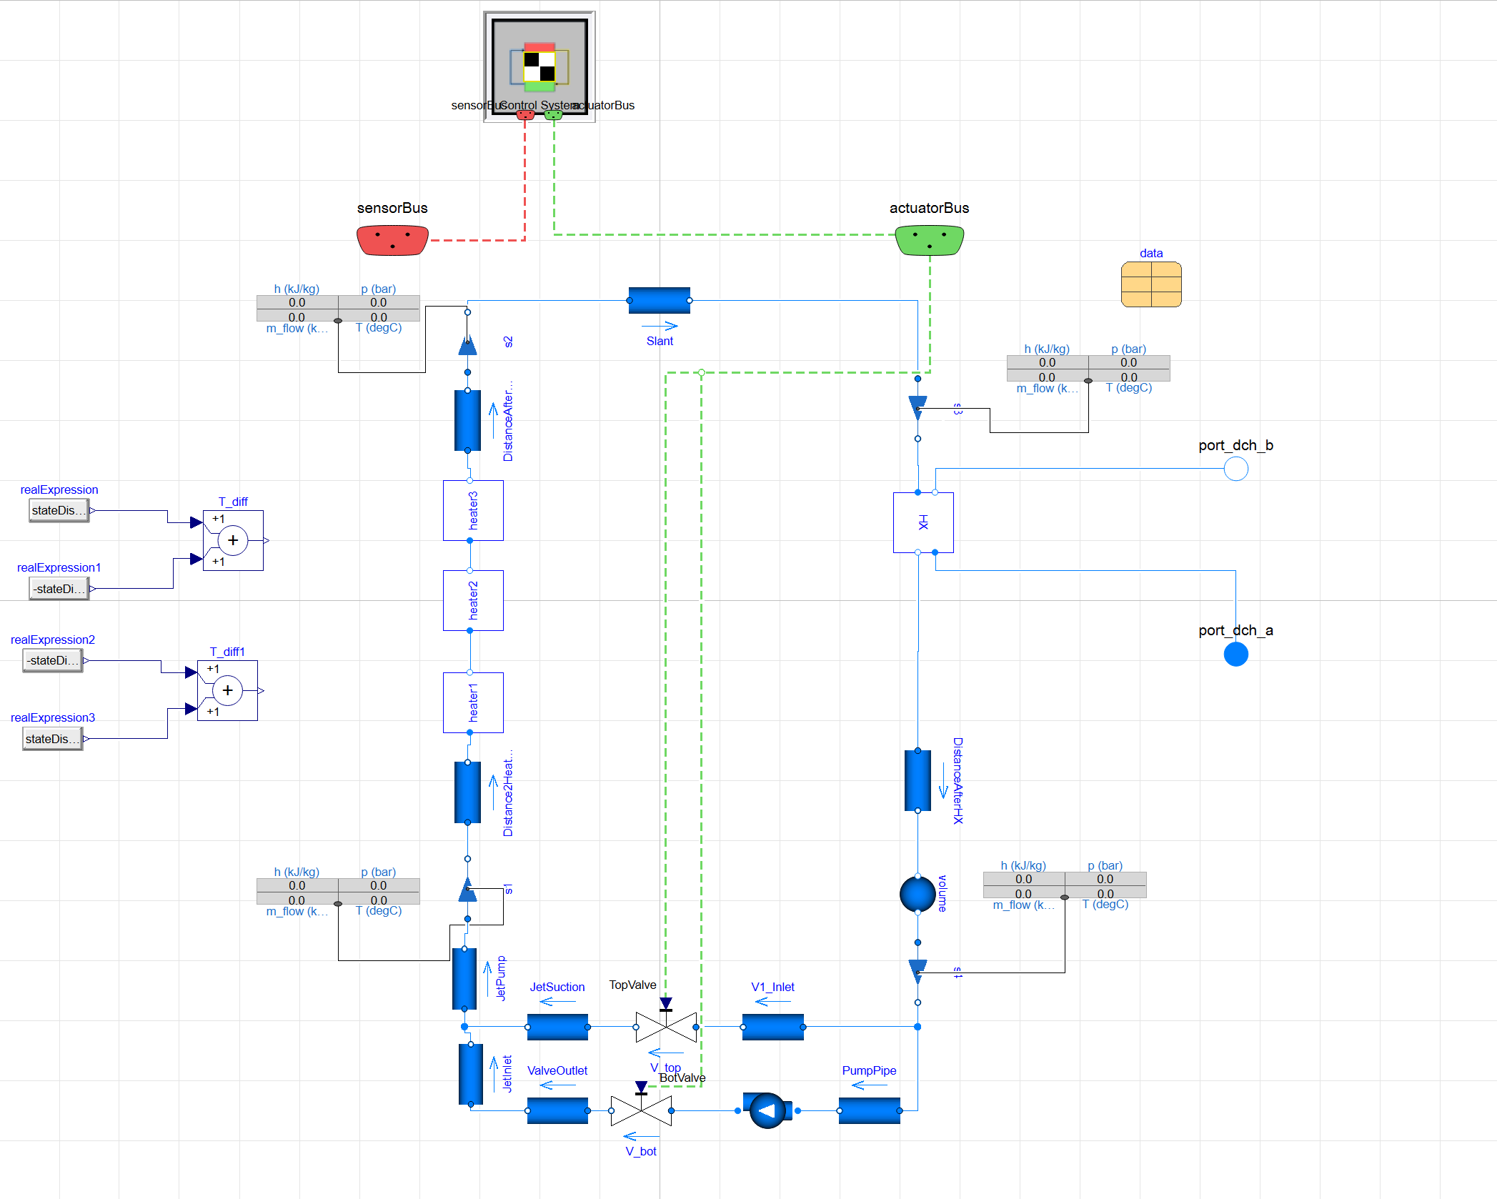
Revamped Dymola Model
Mostly physical dimensions
  Need updated measurements for top half of the loop
Compressed components for:
  Heaters
  Heat exchanger
  Jet pump
Control system has been setup to be easily swappable
Data card updated to encompass more dimensions for easy modification

Slide 4
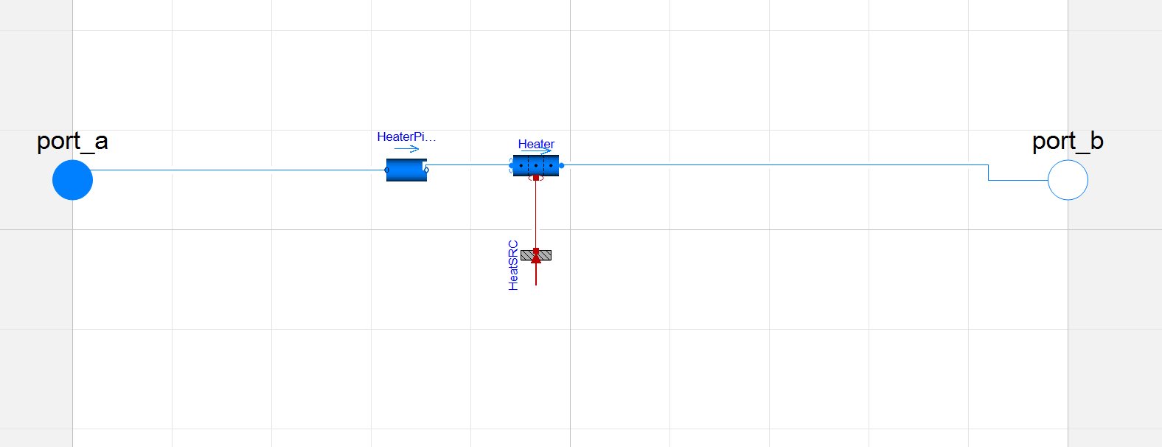
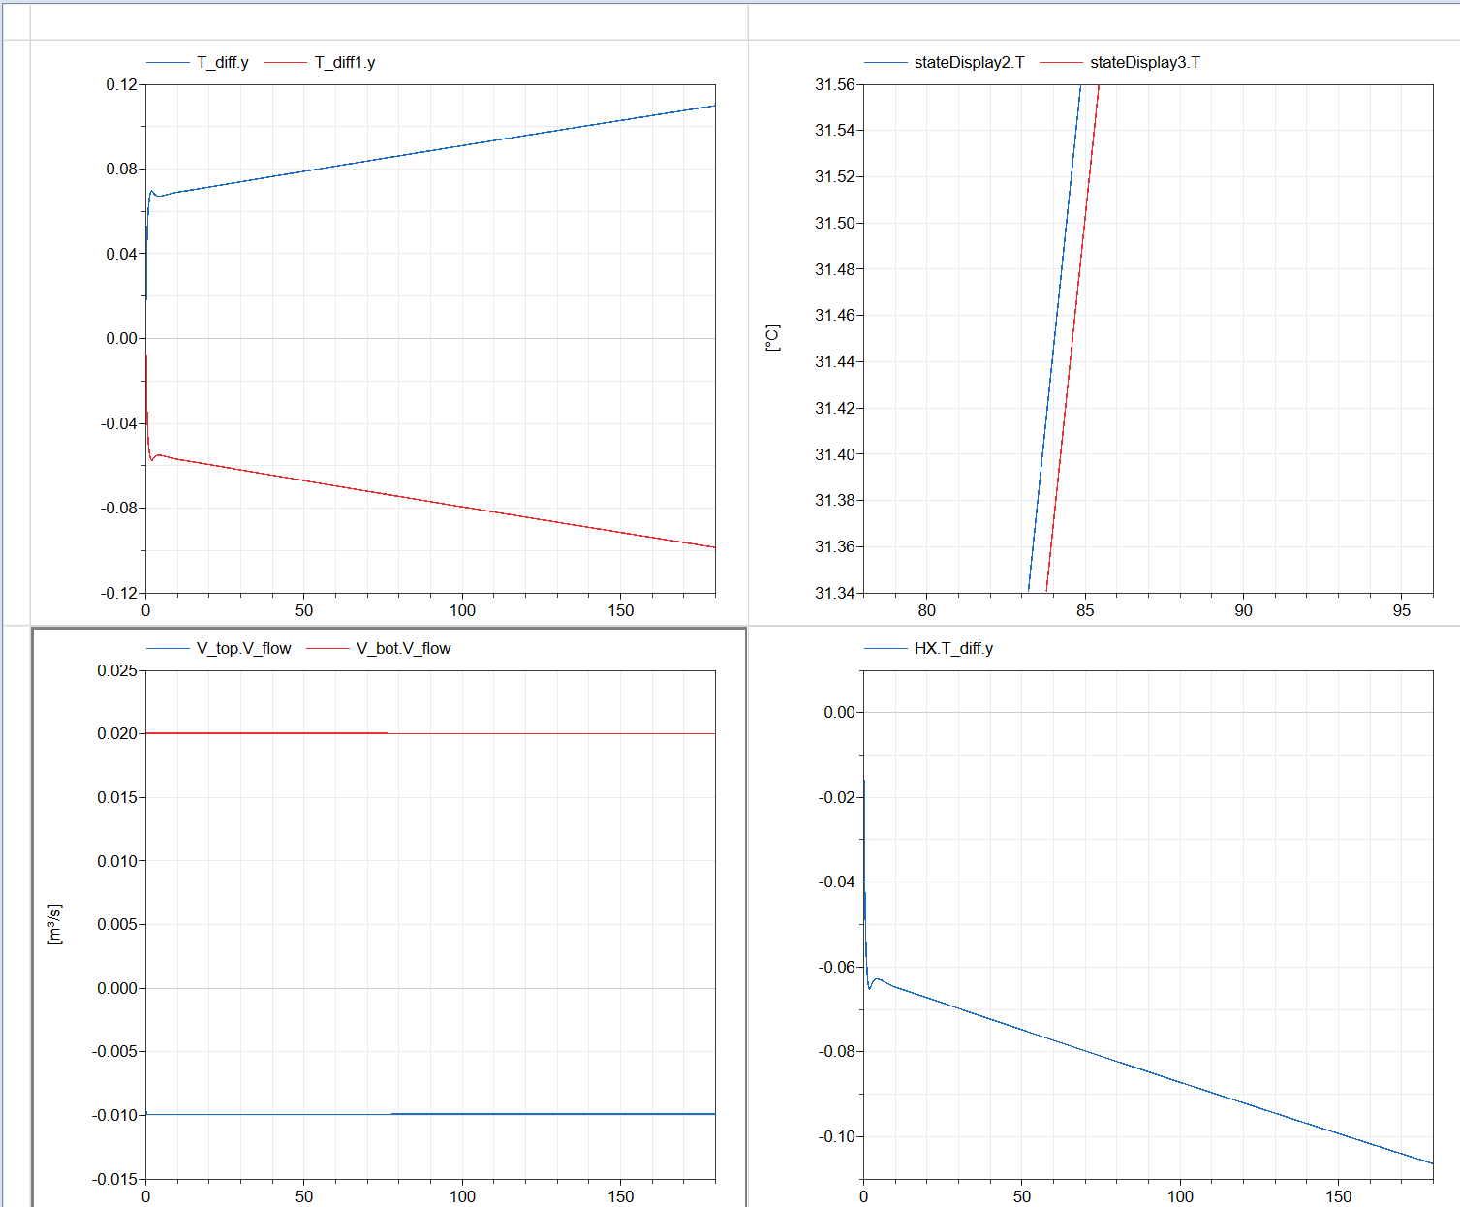
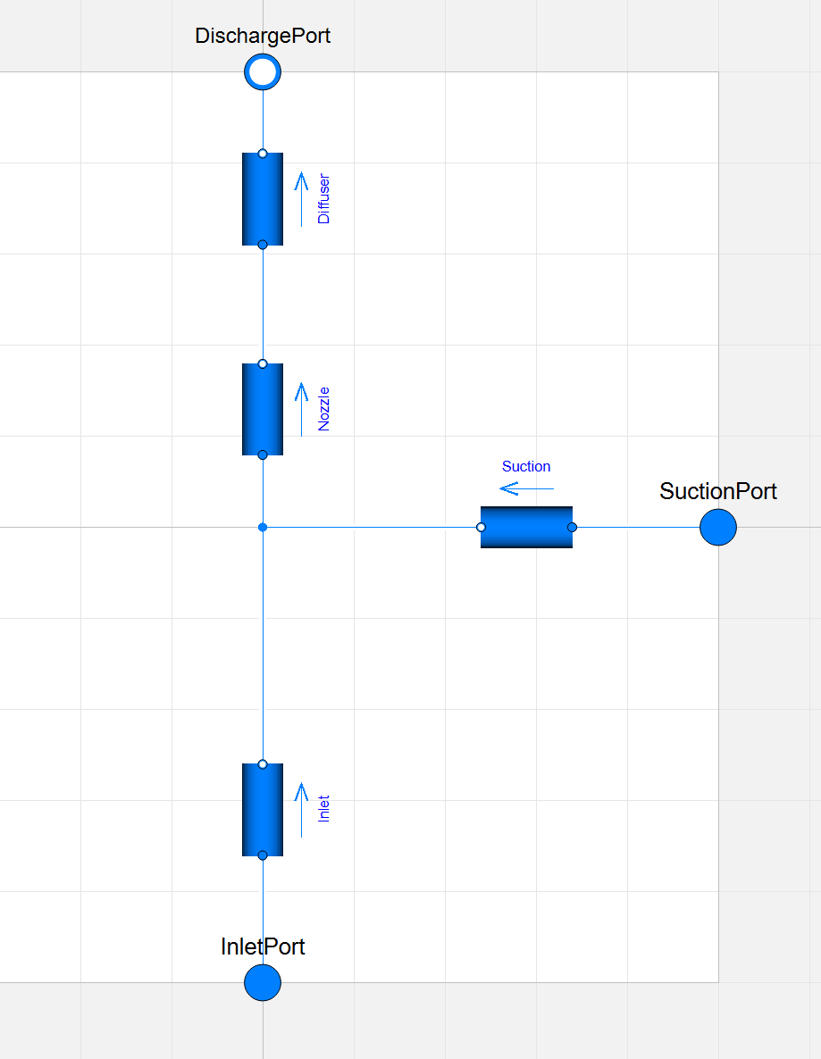
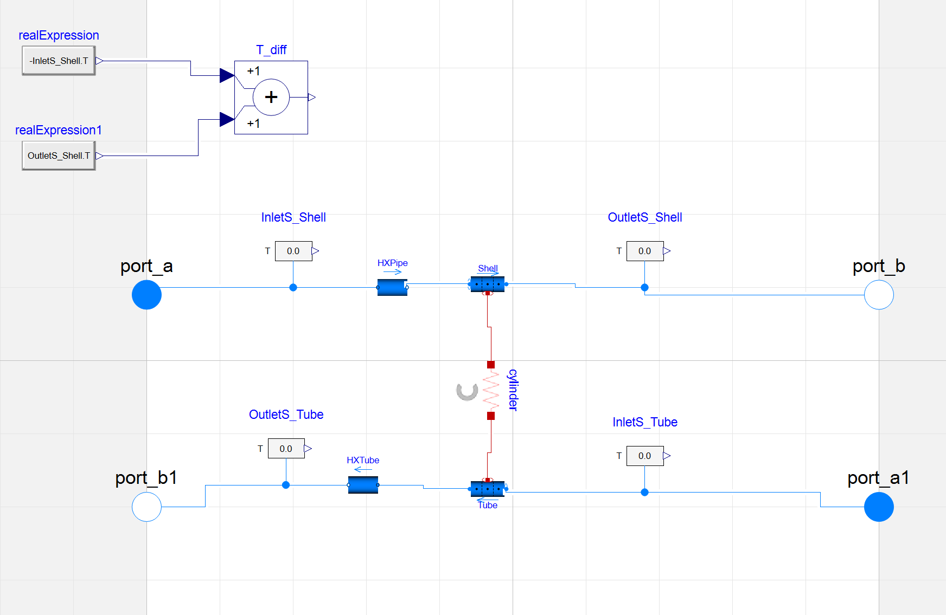
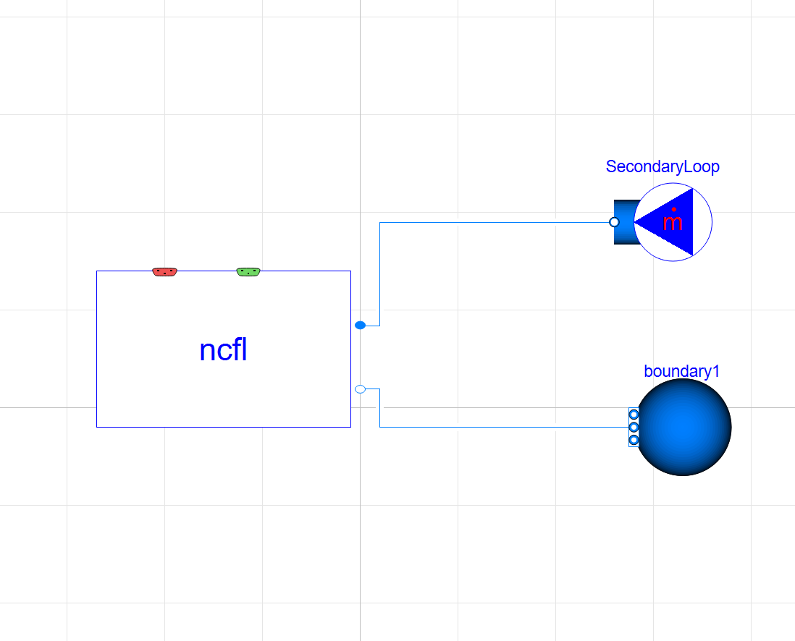
References

Slide 5
Python Integration for the Dymola Model and New Tasks
Met with Linyu and determined that it would be sufficient to implement a simpler Python relationship for the NCFL(still staying away from FMUs).
Began working on script to execute Dymola simulations for the NCFL with modified input files
Willing to help Linyu with Discharge code application once NCFL task is complete.
Future Objectives:
  Begin comparing NCFL runs to experimental data
  Finish Python integration and mimic DeepLynx model for HITB
Challenges:
  Had to shift working directory to local computer
  Ran into some trouble with DeepLynx installation

